Slide 1
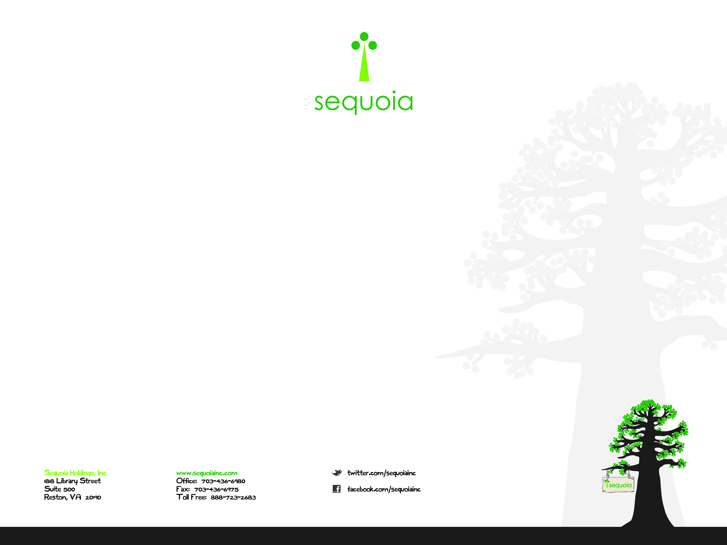

AWS Essentials
Sequoia AWS Boot Camp 2014

Slide 2
Sequoia AWS Partner
Sequoia has been recognized as a standard tier consulting partner!!
Online Partner Training
https://www.apn-portal.com/home/home.jsp
use your sequoia email account and use the sequoiainc.com domain when promoted
Click “Training” from the menu bar
Click "Enter the AWS Training Portal" on your right
Click "AWS Business Professional Course" course on your left
Click "AWS Technical Professional Course" course on your left
Email me your AWS Completed Transcript to add to our scorecard

Slide 3
Essentials Overview
Introduction to AWS
AWS Storage
AWS Compute & Networking
AWS Database Services
AWS Deployment & Management
Next Steps

Slide 4
Introduction to AWS
What is Cloud Computing?
Use of computing resources (hardware/software) that are delivered as a service over a network.
Infrastructure as a Service (IaaS)
Amazon Web Services (AWS)
Amazon’s answer for IaaS (2006)
Web based cloud services for storage, computing, networking, database and management.
Large and Small Businesses Like the “On-Demand” pay as you go model.

Slide 5
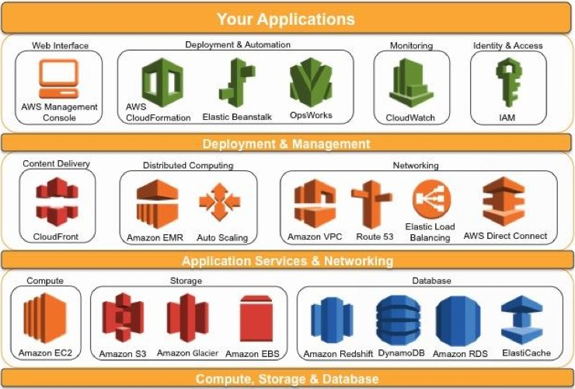
Introduction to AWS

Slide 6
Introduction to AWS
AWS Console Demonstration

Slide 7
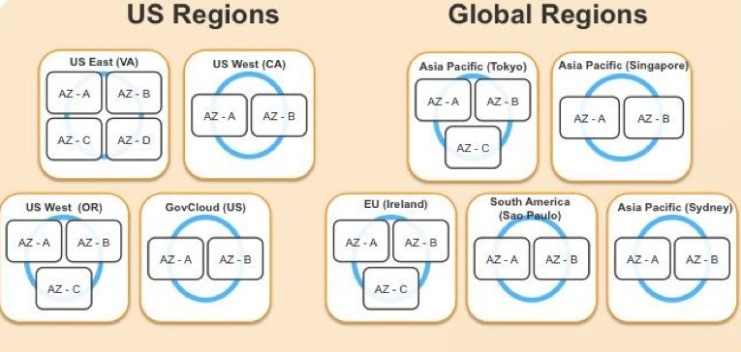
AWS Regions & Availability Zones
AZ’s – group of one or more datacenters, usually connected w/ very high speed fiber
Regions – group of AZs for HA, Load Balancing, Failover
Customer can decide where apps/data reside
Recommended to provision your resources across multiple AZs for HA, DR support.

Slide 8
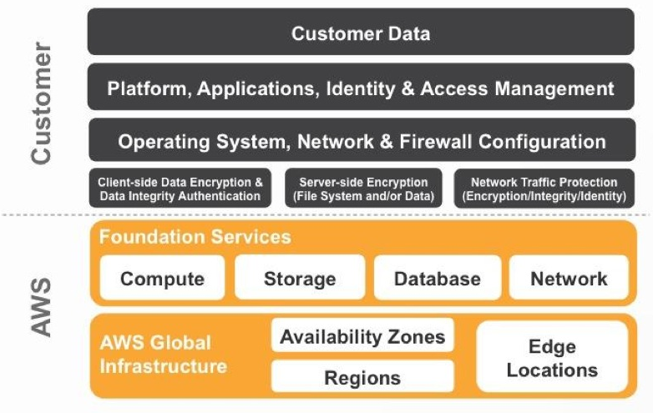
Responsibility

Slide 9
AWS Storage

Slide 10
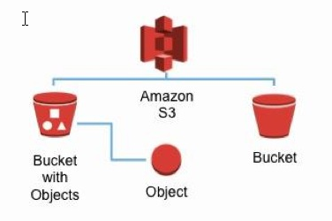
AWS Storage
Simple Storage Service (S3)
Storage “buckets” designed for fast, scalable and durable support aka “Dropbox for AWS”
Buckets are logical containers for objects (100 max)
Objects can be accessed via URL w/ access control
Used for multiple sources (logs, archives, backups, etc)

Slide 11
AWS Storage
Simple Storage Service (S3)
Price: Pay for what you use
Facts:
100 limit buckets per account
Unlimited objects in a bucket
Objects up to 5TB in size
HA designed for 99.999999999% durability
Access logs for auditing
Encryption is available
Provides standards-based SOAP/REST interfaces
Amazon Glacier
Optimize for “Infrequently accessed” data

Slide 12
AWS Storage
Amazon Elastic Block Store
Persistent block level storage volumes
Attached EBSs to running AWS instances
Similar to added another unformatted “C:\” Drive or “/data” volume – Virtual Hard Drive
Suitable for apps like database, file systems or raw storage
EBS Facts
Can be used for RAID configuration
Pay for what you use – General, Provisioned, Magnetic
Max Volume Size: 1TB
Supports Encryption
SSD – Solid State Drives
EBS Vols are replicated within a single AZ
Backup via Snapshots - Copy across multiple Regions
Supports Advanced Security

Slide 13
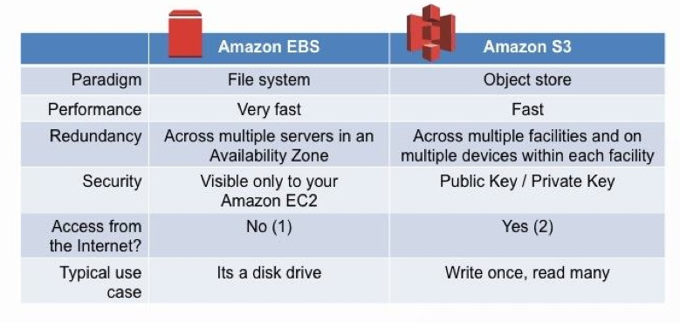
AWS Storage
S3 vs EBS Summary

Slide 14
AWS Compute & Networking

Slide 15
AWS Compute & Networking
Elastic Compute Cloud (EC2)
Resizable compute capacity in the cloud
Virtual Machine or Image – Windows or Linux
Fast, Cheap Images – Multiple Sizes, Deploy Across Multiple Regions or AZs
Instance Types: Memory, Storage, Network Performance
Instance Pay Options: On Demand, Reserved, Spot
Amazon Machine Image (AMI)
Encrypted machine image or “template” stored in S3
Building blocks of EC2 Instances
Pre-configured for quick EC2 spins or customize
Oracle, SAP, Microsoft, AWS Marketplace AMIs

Slide 16
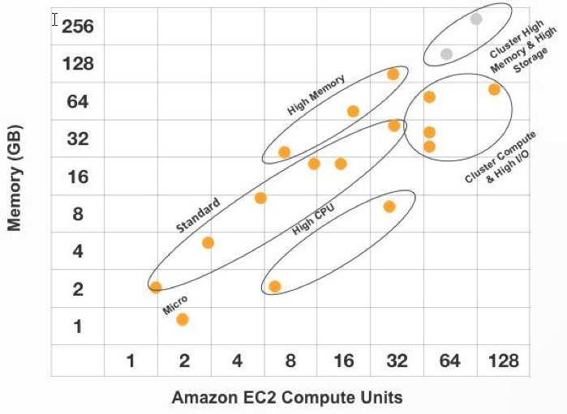
AWS Compute & Networking
EC2 Instance Types

Slide 17
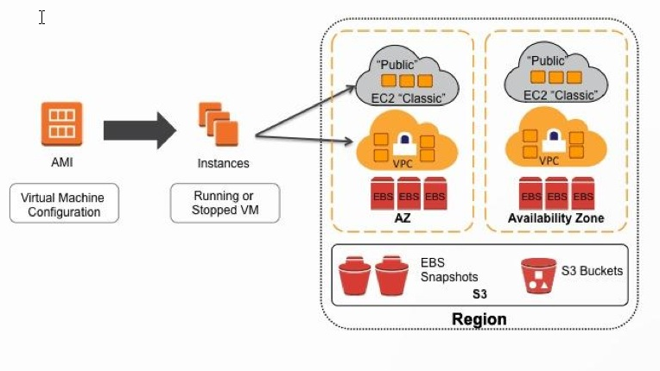
AWS Compute & Networking
EC2 Example

Slide 18
AWS Compute & Networking
Elastic MapReduce (EMR)
Hosted Hadoop framework used to process large amounts of data (EC2 + S3)
Auto Scaling
Allows you to automatically scale your EC2 capacity up or down based on pre-defined definitions
Great for applications that experience “spikes”

Slide 19
AWS Compute & Networking
Virtual Private Cloud (VPC)
Isolated section within AWS that you define for security purposes
IPs, Subnets, Route Tables and Gateways
AWS Direct Connect
Direct connection to AWS
Route 53
Solution for application routing, low latency
Auto routes queries to nearest DNS server
Elastic Load Balancing
Auto distributes traffic across multiple EC2 Instances
Detects unhealthy instances and reroutes traffic
Can support across multiple AZs

Slide 20
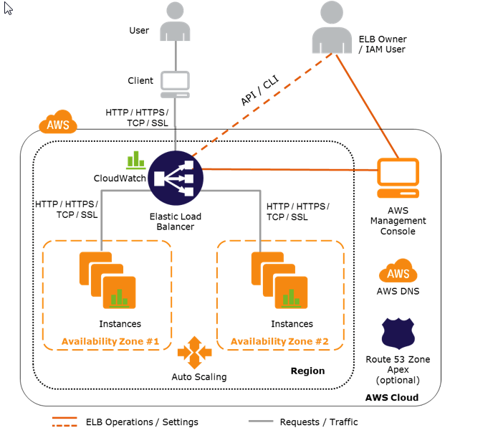
AWS Compute & Networking

Slide 21
AWS Database Services

Slide 22
AWS Database Services
Relational Database Services (RDS)
MySQL, Oracle, MS-SQL or PostgreSQL
Provisioned instances with storage, throughput, etc optimized for fast/consistent performance.
BYOL (Bring your own license) or License Included
Patching/Backups can be automated
HA/Failover via across multiple AZs
Connect via AWS “end point” from console or API
Up to total of 40 DB RDS Instances

Slide 23
DynamoDB
DynamoDB is an AWS managed NoSQL database service offered within the AWS framework
NoSQL (Not Only SQL) Db: An alternative to traditional Relational Db model that provides a highly optimized design for quick reads/writes – Popular with Big Data/Cloud Computing
Key-Value: provides a simple data model structure where data is indexed by a key (hash and/or range) – allows very fast I/O
Other NoSQL Options Include:
Column Store: Hbase, Cassandra, Accumulo, Cloudera
Document Store: MongoDB, CouchDB, Mark Logic

Slide 24
DynamoDB
Ease of Use: Hosted environment within AWS framework
Do not have to worry about: DBA tasks (installation, maintenance, hardware provisioning, patching, etc)
API Calls, Console, SKDs are developer friendly
Backups via AWS Data Pipeline
Availability, Scalability and Performance: AWS Benefits
Syncs across multiple AZs, load balancing, SSDs low latency
No downtime, no table size limits, unlimited storage
Security: Use of IAM policies for FGAC (fine grain access control)
Integration of AWS Tools: CloudWatch, Elastic Map Reduce, CloudSearch
Cost: Pay for what you use model is brilliant
Limitations: Can be expensive, API/Index limitations, etc

Slide 25
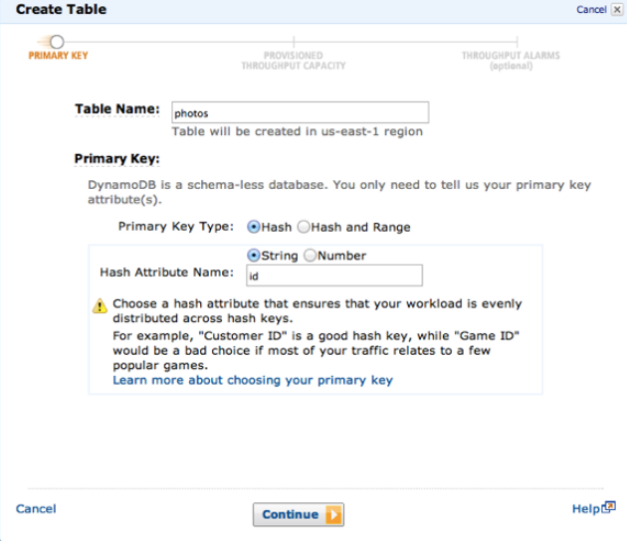
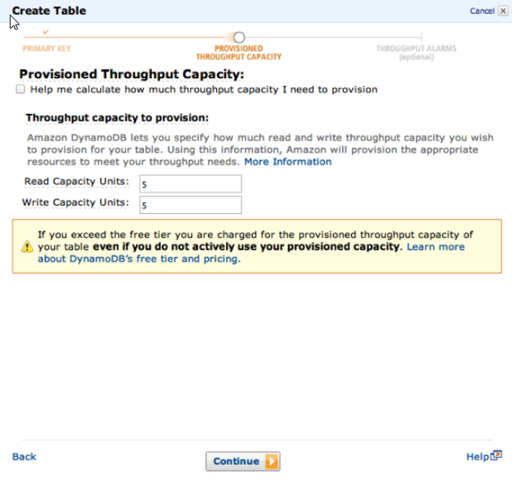
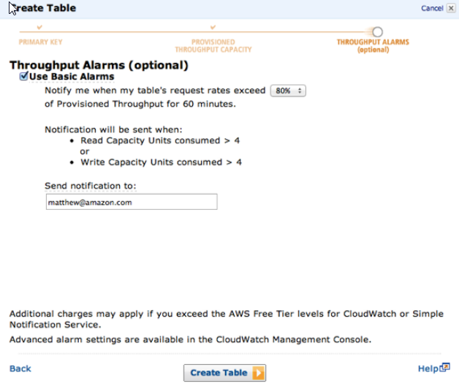
DynamoDB
Flexible Data Model: Key/Attribute pairs
No schema required
Two Decisions (Primary Keys/Throughput) + Three Clicks = Ready For Use
Provisioned Throughput: reserve IOPS for read/writes

Slide 26
AWS Deployment & Management

Slide 27
AWS Deployment & Management
AWS Identify and Access Management (IAM)
Service for security and user/group permissions
Manage Users, access keys and permissions to control AWS resources
Supports FGAC (Fine Grained Access Control)
AWS CloudWatch
Service for monitoring, managing performance/user metrics
Configure alarm actions for proactive management
Available via console, APIs, SDKs or CLI

Slide 28
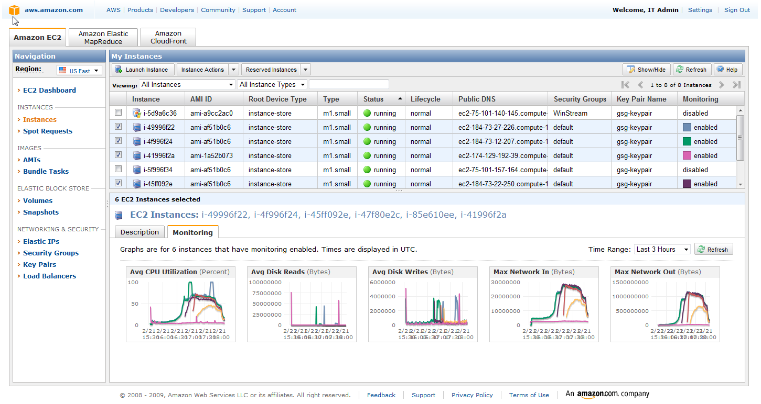
AWS CloudWatch

Slide 29
AWS Deployment & Management
Elastic Beanstalk
Application deployment support
Deployment, capacity provisioning, load balancing, auto scaling and monitoring
Supports Java, .NET, PHP, Node.js, Python, Ruby, etc
CloudFormation
Collection of templates (related AWS resources) to deploy and provision in a orderly/predictable fashion
Templates are simple JSON formatted files

Slide 30
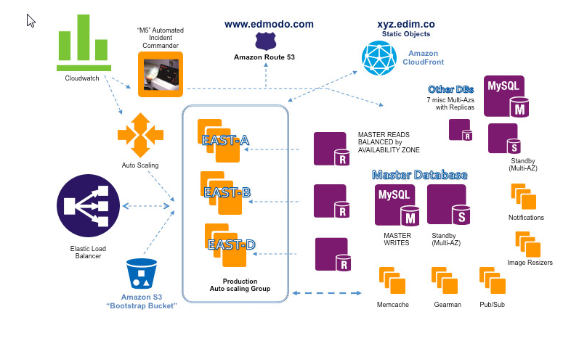
Pulling It Together

Slide 31
AWS Next Steps
Online Documentation
http://aws.amazon.com/documentation/
Self Paced Labs
http://aws.amazon.com/training/self-paced-labs/
Training
http://aws.amazon.com/training/
Videos
https://www.youtube.com/user/AmazonWebServices/Cloud
Certification
https://aws.amazon.com/certification/

Slide 32
AWS Self Pace Labs
AWS Self Pace Labs
https://run.qwiklabs.com/
Free or need Tokens for Labs
Sequoia allowances are available for Token Use
Training allowance or technical book/software
Expense for reimbursement
Need certificate of completion from lab!!

Slide 33
AWS Certification
AWS Certification
https://aws.amazon.com/certification/
Solutions Architect
Associate
Professional
Master (planned)
Developer
Associate
Professional (planned)
SysOps Administrator
Associate
Professional (planned)
Sequoia will pay for your exam fee!!

Slide 34
AWS Experience
Sequoia Internal Projects
Used for “demonstrated experience”
Please contact me if interested

